Slide 1
Numerical Methods Lec 9
By
Asst. Prof. Syed Shujaat Hussain

Slide 2
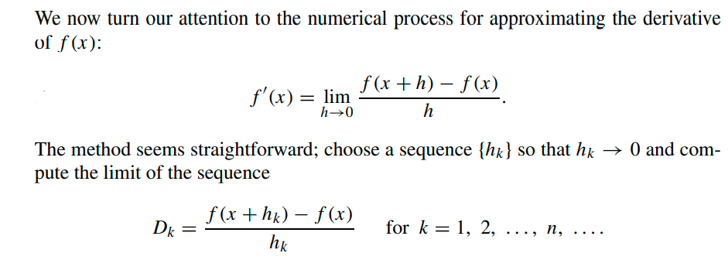
Numerical Differentiation

Slide 3
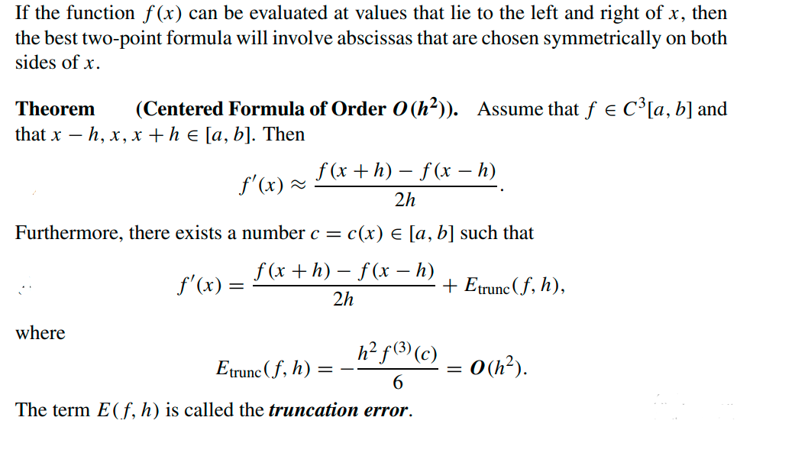
Central-Difference Formulas

Slide 4
Example
Let f (x) = cos(x).
(a) Use Central difference formulas with step sizes h = 0.1, 0.01, 0.001, and
0.0001, and calculate approximations for f’(0.8). Carry nine decimal
places in all the calculations.
(b) Compare with the true value f‘(0.8) = − sin(0.8).
Solution : (a) Using formula (3) with h = 0.01, we get
(b) The error in approximation formulas turns out to be −0.000011941

Slide 5
Class Activity
Q: Let f (x) = sin(x), where x is measured in radians.
(a) Calculate approximations to f’(0.8) using central difference formula
with h = 0.1, h = 0.01, and h = 0.001.
( Carry eight or nine decimal places.)
(b) Compare with the value f’(0.8) = cos(0.8).

Slide 6
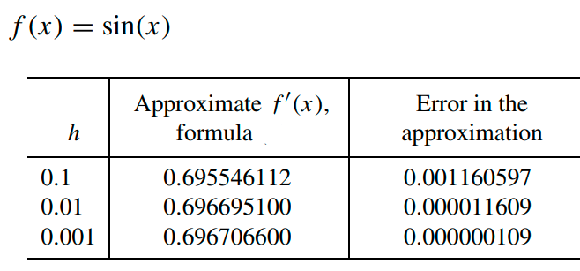
Solution (Approximating the Derivative)

Slide 7


Class Activity
Q: Compute using “central difference” formula
Let f (x) = x³ and find approximations for f’(2).
(a) Use formula with h = 0.05
(b) Compute the truncation error o(h²)

Slide 8
Solution

Slide 9
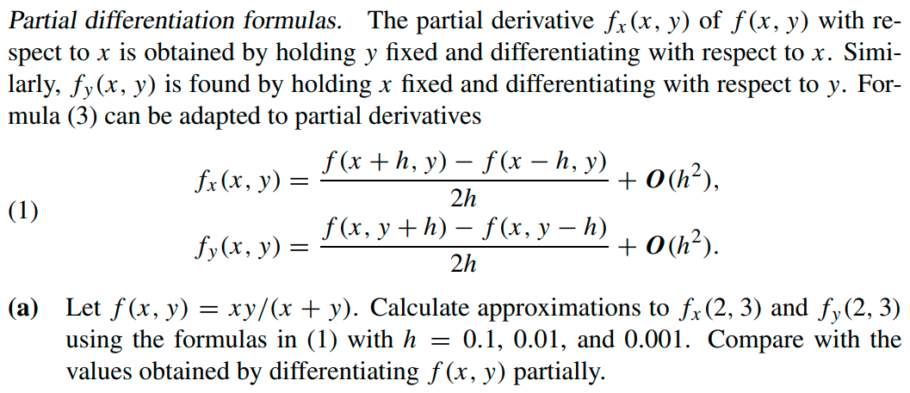
Test Your ability !
Q:

Slide 10
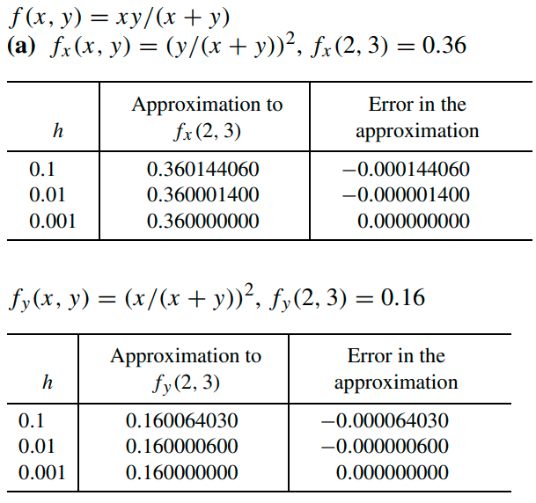
Solution

Slide 11
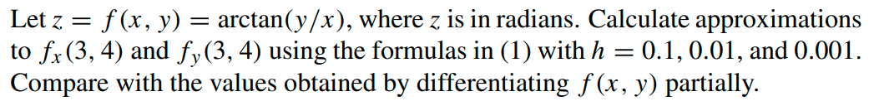
Test your ability!
Q.

Slide 12
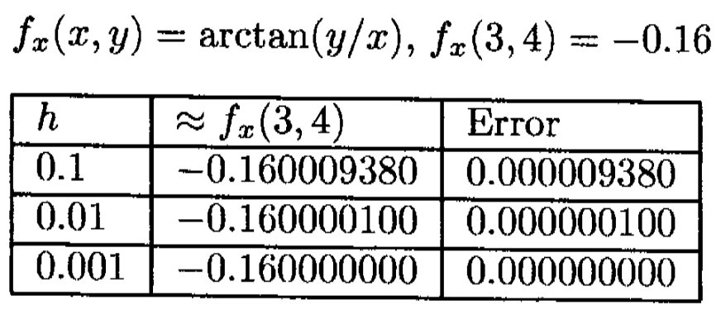
Solution

Slide 13
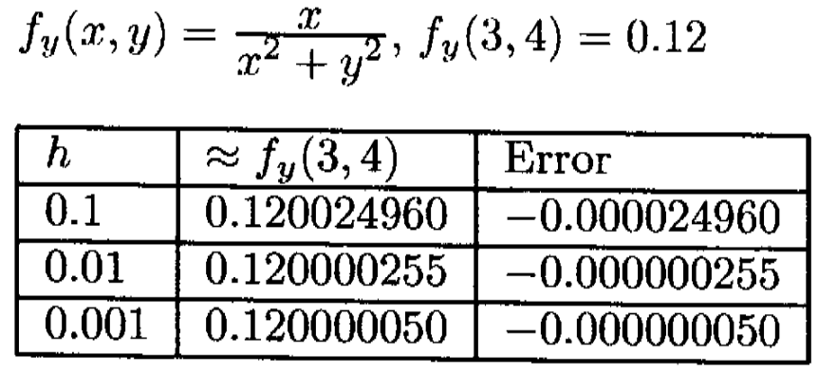
Solution

Slide 14
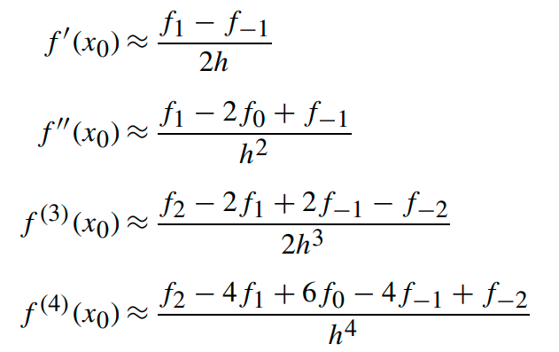
More Central-Difference Formulas of O(h²)

Slide 15
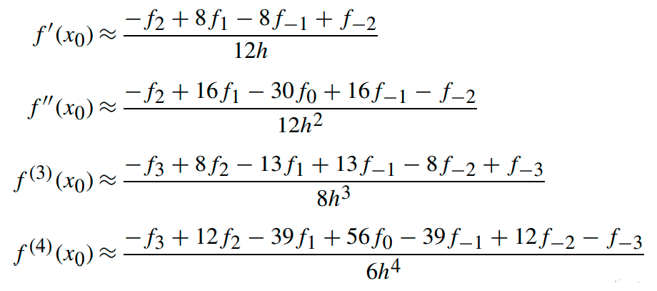
More Central-Difference Formulas of O(h⁴)

Slide 16
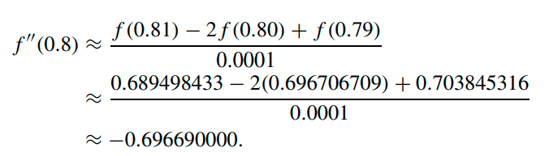
Example (Second Derivative)
Q: Let f (x) = cos(x).
(a) Use formula (6) with h = 0.1, 0.01, and 0.001 and find approximations to f”(0.8). Carry nine decimal places in all calculations.
(b) Compare with the true value f (0.8) = − cos(0.8).
Solution: (a) The calculation for h = 0.01 is
(b) The error in this approximation is −0.000016709.

Slide 17
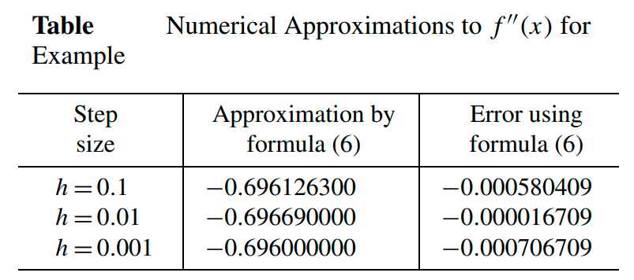

Slide 18
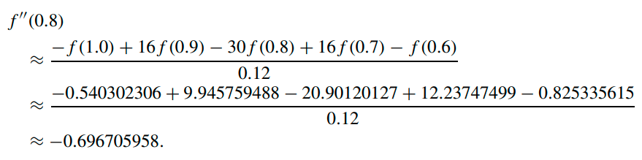
Example: Second Derivative O(h⁴)
Q: Let f (x) = cos(x).
Use formula (12) with h = 1.0, 0.1, and 0.01 and find approximations to f’’ (0.8).
Carry nine decimal places in all the calculations.
(b) Compare with the true value f (0.8) = − cos(0.8).
Solution: (a) The calculation for h = 0.1 is
(b) The error in this approximation is −0.000000751.

Slide 19
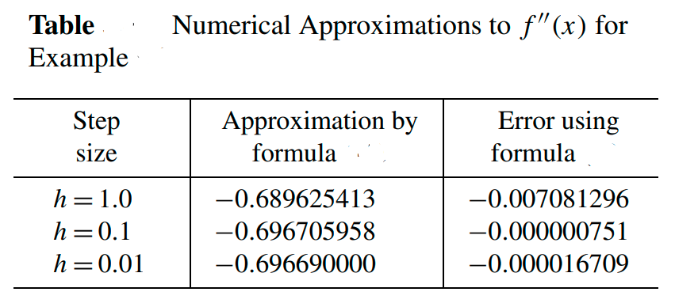
Results from above example

Slide 20

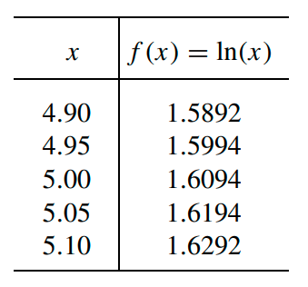


Class Activity
Q: Consider the table for f (x) = ln(x) rounded to four decimal places.
(a) Use formula O(h2) with h = 0.05 to approximate f’’(5).
(b) Use formula o(h2) with h = 0.01 to approximate f’’ (5).
(c) Use formula o(h4) with h = 0.05 to approximate f‘’(5).
(d) Which answer, (a), (b), or (c), is most accurate?

Slide 21
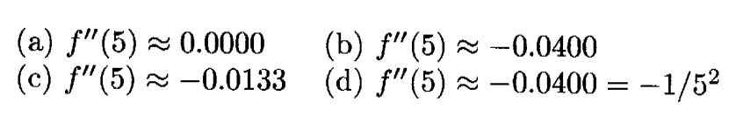
Solution

Slide 22
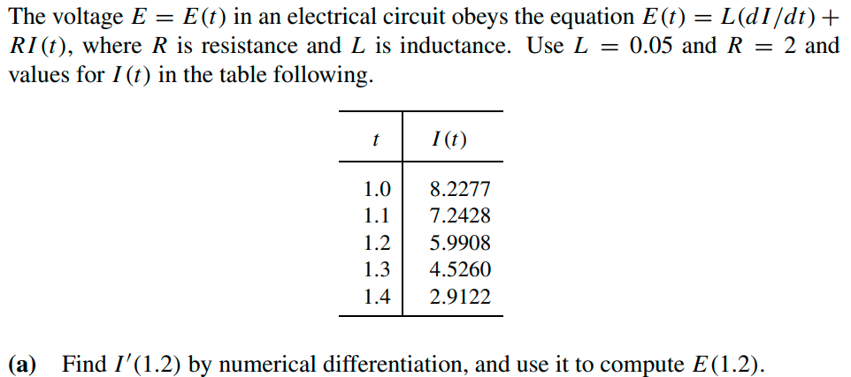
Test your ability!
Q.
Use O(h2) for solving above question.
b) Use O(h4) for solving above question.

Slide 23

Solution
a) O(h2) :
O(h4): gives

Slide 24
Solution
a) O(h2) :
b) O(h4): gives

Slide 25
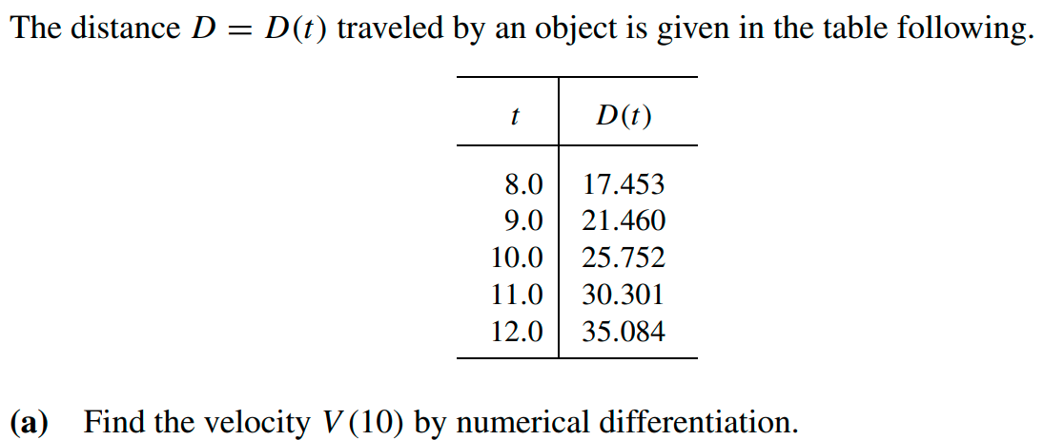
Class Activity
Q.
Use O(h2) and O(h4) formulae.

Slide 26

Solution
O(h2):

Slide 27

Solution
O(h2):
O(h4): yield

Slide 28
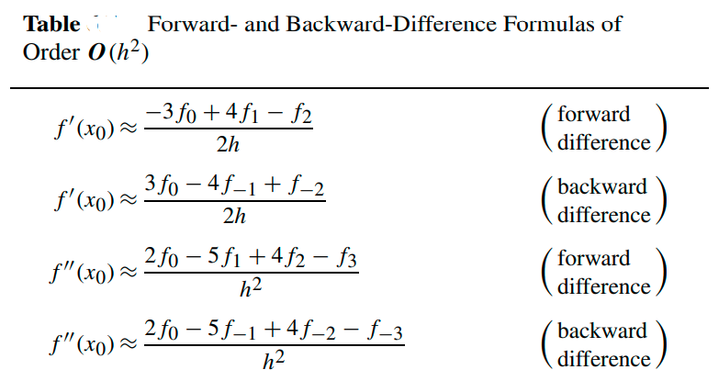
Forward and Backward Difference Formula

Slide 29
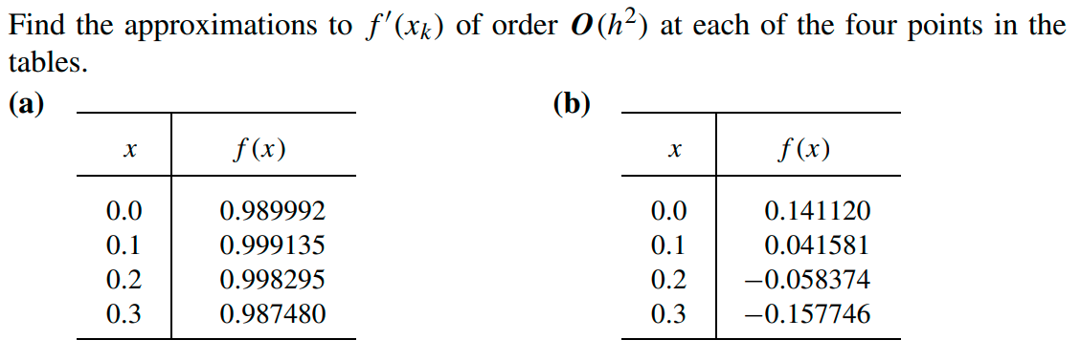

Class Activity
Q.

Slide 30
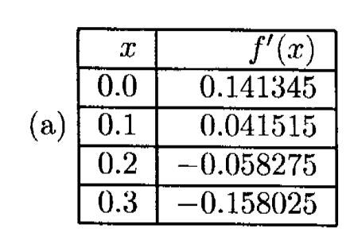

Solution

Slide 31
Solution

Slide 32
Solution

Slide 33
Solution

Slide 34
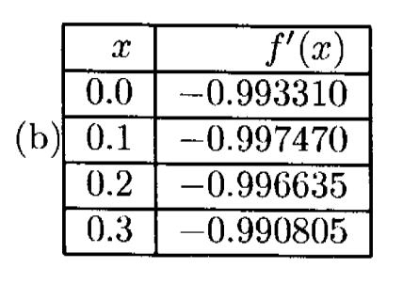
Solution

Slide 35
Solution

Slide 36
Solution

Slide 37
Solution

Slide 38
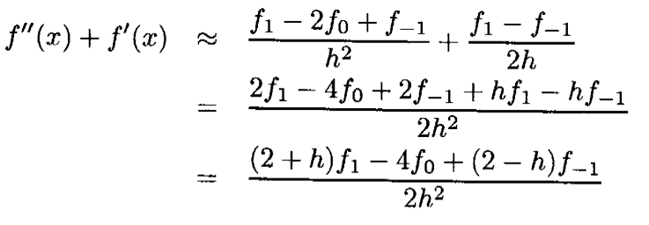
Use in Differential Equations
The numerical solution of a certain differential equation requires an approximation to f’’(x) + f’(x) of order O(h²).
(a) Find the central-difference formula for f’’(x) + f’(x) by adding the formulas for f‘’(x) and f’(x) of order O(h²).
(b) Find the central-difference formula for f’’(x) + f’(x) by adding the formulas for f‘’(x) and f’(x) of order O(h⁴).

Slide 39



Solution
For O(h4):
$f^{′′}(x)+f^{′}(x)$ = +
= $\frac{{−(1+h)f}_{2} + 8\left(2+h\right)f_{1} − 30f_{0} + 8\left(2−h\right)f_{−1} − (1−h)f_{−2}}{{12h}^{2}}$

Slide 40
Class Activity
Q: The numerical solution of a certain differential equation requires an approximation to f’’(x) + f’(x) of order O(h²)
Find the “forward-difference formula” for f’’(x) + f’ (x) by adding the
formulas for f‘‘(x) and f’(x) of order O(h²)

Slide 41
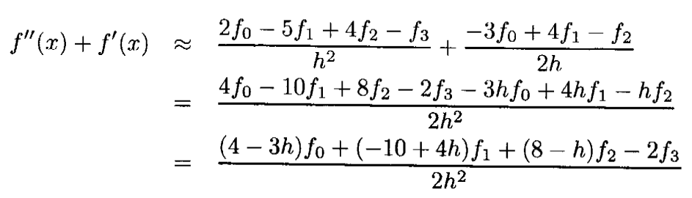
Solution

